Slide 1
Welcome to First Time User Setup
Login:
Password:
Notes:
Shown only during initial setup

Slide 2
First Time User Setup
Please setup a password for the Administrator Account
New Password:
Re-enter new password:

Slide 3
Welcome, Administrator
Upload staff users
Upload course room data
Upload building data
Note: staff users have not been uploaded yet
Note: course room data has not been uploaded yet
Note: building data has not been uploaded yet
Notes:
Messages will disappear once software detects a user csv file, a course csv and a building csv.

Slide 4
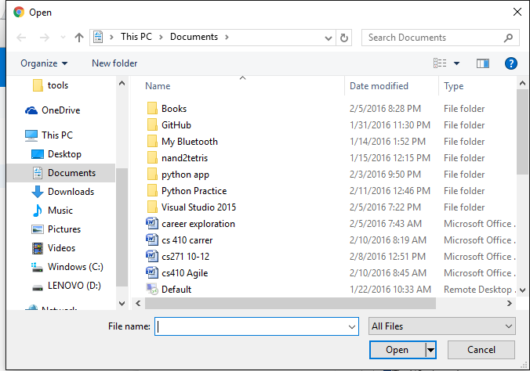
Notes:
File path browser comes up

Slide 5
Upload Successful!
Continue

Slide 6
Upload Failed!
Continue
Notes:
Shown only if admin’s upload is unsuccessful

Slide 7
Professor Login
Email:
Password:
Notes:
Redirect here from view reservation homepage. Administrator will come here to login as well.

Slide 8
First Time Staff Setup
Please setup a password for [some_professor@someschool.edu] Account
New Password:
Re-enter new password:
Notes:
Only shown during professor’s first login.

Slide 9
Welcome, Some Professor!
View Rooms Reserved
Reserve a Room
Un-reserve a Room

Slide 10
View Rooms Reserved
Professor Login
Building | Date | Start Time | End Time | Room Number
Note: this page will be accessible to anyone on the internet

Slide 11
View Rooms Reserved
Building | Date | Start Time | End Time | Room Number
Some Building
Student Center
Some Hall
Some Rich Donor
Another Hall
Another Building
Final Hall

Slide 12
View Rooms Reserved
Building | Date | Start Time | End Time | Room Number
Some Hall | Feb 12
 | Feb 13
 | Feb 14
 | Feb 15
 | …

Slide 13
Search Results
Building | Date | Start Time | End Time | Room Number
Some Hall | Feb 12 | 10:00AM | 11:00AM | SH101
Some Hall | Feb 12 | 10:00AM | 11:00AM | SH202
Some Hall | Feb 12 | 10:00AM | 11:00AM | SH105
Some Hall | Feb 12 | 10:00AM | 11:00AM | SH 103
Some Hall | Feb 12 | 10:00AM | 11:00AM | SH205
Some Hall | Feb 12 | 10:00AM | 11:00AM | SH302

Slide 14
Reserve a Room
Building | Date | Start Time | End Time | Room Number
Some Hall | Feb 12 | 10:00AM | 11:00AM | SH101
Some Hall | Feb 12 | 10:00AM | 11:00AM | SH202
Some Hall | Feb 12 | 10:00AM | 11:00AM | SH105
Some Hall | Feb 12 | 10:00AM | 11:00AM | SH 103
Some Hall | Feb 12 | 10:00AM | 11:00AM | SH205
Some Hall | Feb 12 | 10:00AM | 11:00AM | SH302
Note: staff only access
Notes:
Shown after user enters criteria for view rooms during reserve a room.

Slide 15
Reserve a Room
Some Professor, you are about to reserve:
Some Hall | Feb 12 | 10:00AM | 11:00AM | SH105
Proceed
Cancel

Slide 16
Reservation Successful
Continue

Slide 17
Reservation Unsuccessful
Continue

Slide 18
Un-reserve a Room
Some Professor, You currently have the following rooms reserved:
Building | Date | Start Time | End Time | Room Number
Some Hall | Feb 18 | 10:00AM | 11:00AM | SH101
Another Hall | Feb 19 | 1:00PM | 4:00PM | AH202
Final Hall | March 5 | 10:00AM | 11:00AM | FH103
Final Hall | March 5 | 2:00PM | 3:00PM | FH 103

Slide 19
Reserve a Room
Some Professor, you are about to reserve:
Final Hall | March 5 | 10:00AM | 11:00AM | FH103
Proceed
Cancel

Slide 20
Reservation Removed
Continue

Slide 21
Reservation Not Removed
Continue

